Slide 1


Welcome to the 10th Annual MMBioS Cell Modeling Workshop!
James R. Faeder
University of Pittsburgh
Thomas Bartol
Salk Institute for Biological Studies
Robert F. Murphy
Carnegie Mellon University
July 11-15, 2022
Rozita Laghaei
Pittsburgh Supercomputing Center

Slide 2
Welcome to the 10th Annual MMBioS Cell Modeling Workshop!
James R. Faeder
University of Pittsburgh
Thomas Bartol
Salk Institute for Biological Studies
Robert F. Murphy
Carnegie Mellon University
Ali Sinan Saglam
Caleb Armstrong
Zarifeh Heidari Rarani
Alex DiBiasi
Adam Husar
Guadalupe García
Burak Kaynak
Mariam Ordyan
Sara Sameni
Joel Yancey
Mohammad Samavat
Margot Wagner
Rachel Mendelsohn
Don Spencer
Ted Zhang
Huangqingbo (Paul) Sun
Rozita Laghaei
Pittsburgh Supercomputing Center
Iván E. Cao-Berg

Slide 3

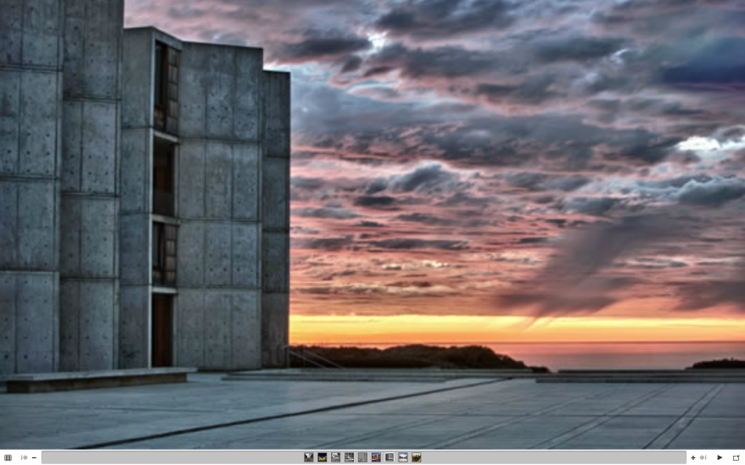
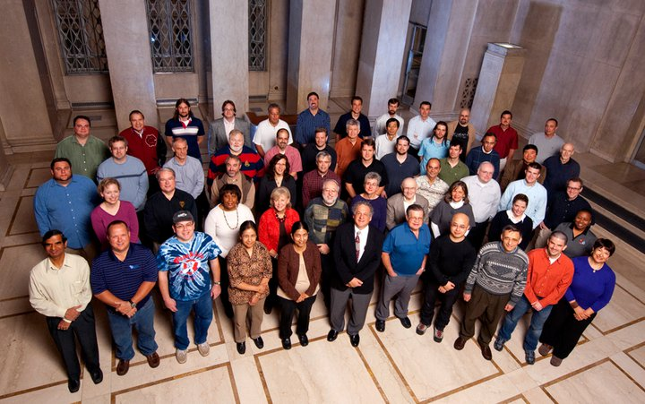
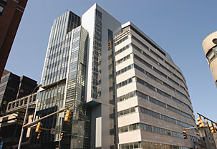
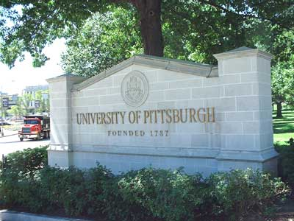
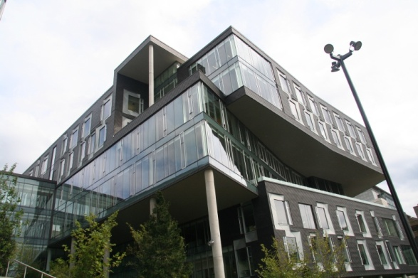
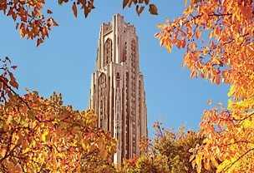

Biomedical Technology Research Resource (BTRR)
High Performance Computing
for
Multiscale Modeling of Biological Systems
Salk
Overarching biological theme:
Spatial organization
Temporal evolution
of signaling events in the central nnervous system & immune system
PSC
PITT
CMU

Slide 4
Rationale
3D Structure at various scales
Dynamics at multiple scales
Integration
Recent advances in experimental and computational technology provide big data
Turning big data into knowledge requires 4D modeling and simulations
Notes:
Accomplishments on modeling intermediate scales

Slide 5
Experimental Technology
Computational Technology
Testable hypotheses Novel technology
4D Modeling & Simulations
Big Data
Statistical Analyses, Machine Learning, Pattern Recognition
Insights into physical mechanisms of function, causality, design principles & rational strategies
Knowledge

Slide 6
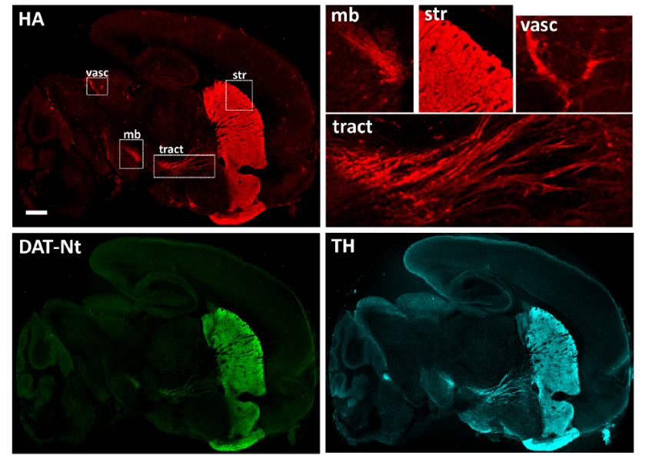
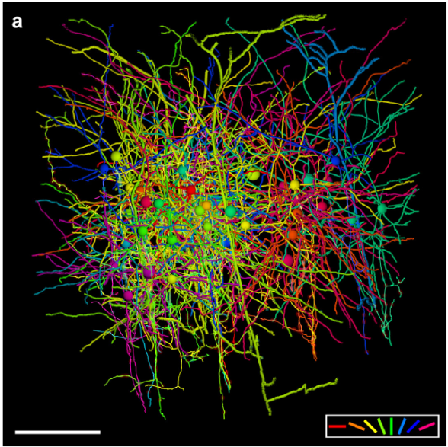
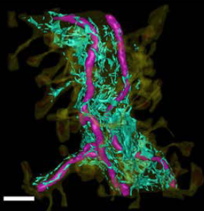
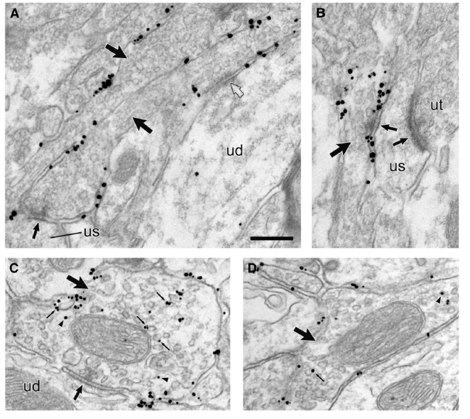
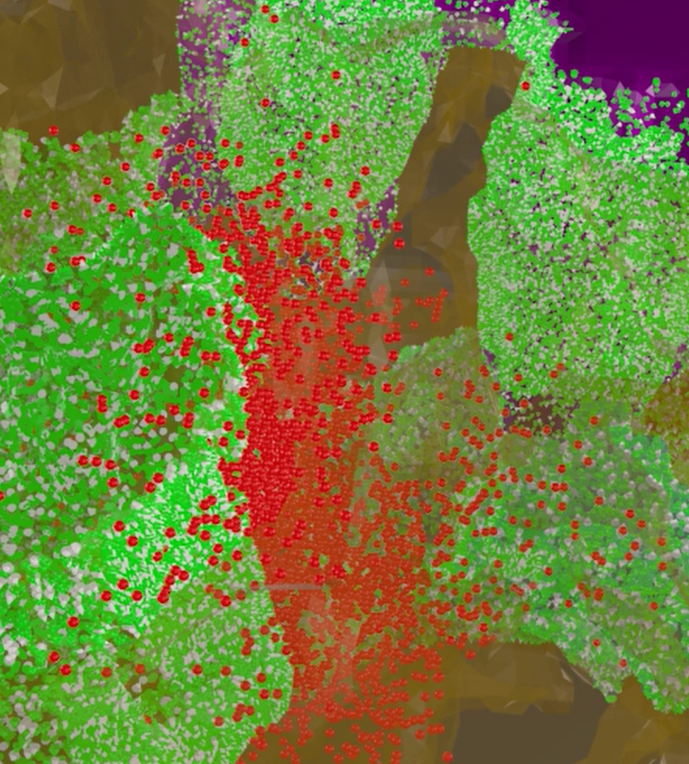
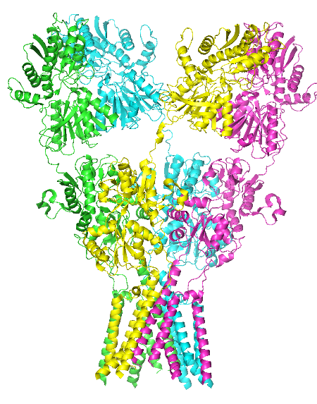
Vision: Leveraging 3D data at multiple scales & resolution
DBP3
DBP5
DBP7
mitochondria
A priority research area:
Use 3D structure/topology data at various scales to
Reconstitute representative and tractable 3D models
Generate information on systems collective dynamics
Predict mechanisms of function
ER
2 mm
150 μm
1 μm
DBP7
immunogold-silver labeled DATs
C&SP20
DBP3
DBP3
265 nm
0.5 μm
100 nm
5 nm
Notes:
A. Distribution of dopamine transporters (DATs) in different regions of the brain of transgenic mouse that expresses hemagglutinin (HA)-bound DAT, observable by fluorescence microscopy. Sagittal slices labeled with TH (cyan) and DAT-Nt antibodies (green) were imaged using scanning confocal microscopy. The upper diagram display the localization of HA bound to DAT) conjugated with Cy3 (red), revealing the regions (e.g. midbrain, striatum, enlarged on the right) that are populated by DATs. Scale bar, 2 mm. (Block et al., 2015) (B) 3D rendering of dendrites and axons, cell bodies (large spheres), and synapses (small spheres) of 50 functionally characterized neurons reconstructed in the
EM volume color-coded by their response to visual stimulation orientation (scale bar: 150 micrometer). (C) (left) reconstruction of a layer 2/3 (L2/3) pyramidal neuron (cell 1) synapsing onto a deep layer apical dendrite (cell 2), reconstructed from EM, and (right) EM micrographs of synapses corresponding to the enclosed squares (same color) on the left. Scale bars: 100 micrometer (left) and 1 micrometer (right). (Lee et al.2016), (D) Electron micrographs showing the localization of immunogold-silver labeled DATs (black dots) in the membranes of the dorsal striatum (scale bar: 0.265 micrometer); (E) Intracellular organelles of the large apical dendrite including the reconstructed ER (cyan/green) and mitochondria (magenta), obtained by reconstruction of 100 serial EM thin sections (50nm thick) for the hippocampal neuropil, using MCell version 3.0 (from Bartol et al Front Synaptic Neurosci. 2015; 7: 17., co-authored by Harris, Kennedy and Sejnowski)
.

Slide 7
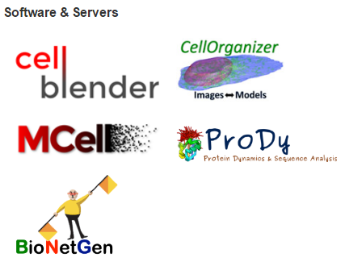
Development of 4 major software/APIs
Molecular modeling
Cell modeling
TR&D1
(Bahar)
TR&D2
TR&D3
(Faeder)
TR&D4
(Murphy)
(Sejnowski)
Images ↔ Models
Image-derived modeling
Network modeling
Notes:
4 major software/APIs have been downloaded more than 150,000 times since 2013

Slide 8
Spatial modeling pipeline
D. P. Sullivan, J. J. Tapia, et al. GLSVLSI’15, 2015.

Slide 9
Systematic investigation of spatial effects in realistic geometries
Detailed biochemical model
Realistic spatial geometries derived from images
Colors correspond to geometries drawn from different regions of cellular shape space

Slide 10
Expanded Pipeline for Rare Event Sampling
Donovan RM, Tapia J-J, Sullivan DP, Faeder JR, Murphy RF, Dittrich M, et al. (2016) Unbiased Rare Event Sampling in Spatial Stochastic Systems Biology Models Using a Weighted Ensemble of Trajectories. PLoS Comput Biol 12(2): e1004611. doi:10.1371/journal.pcbi.1004611

Slide 11
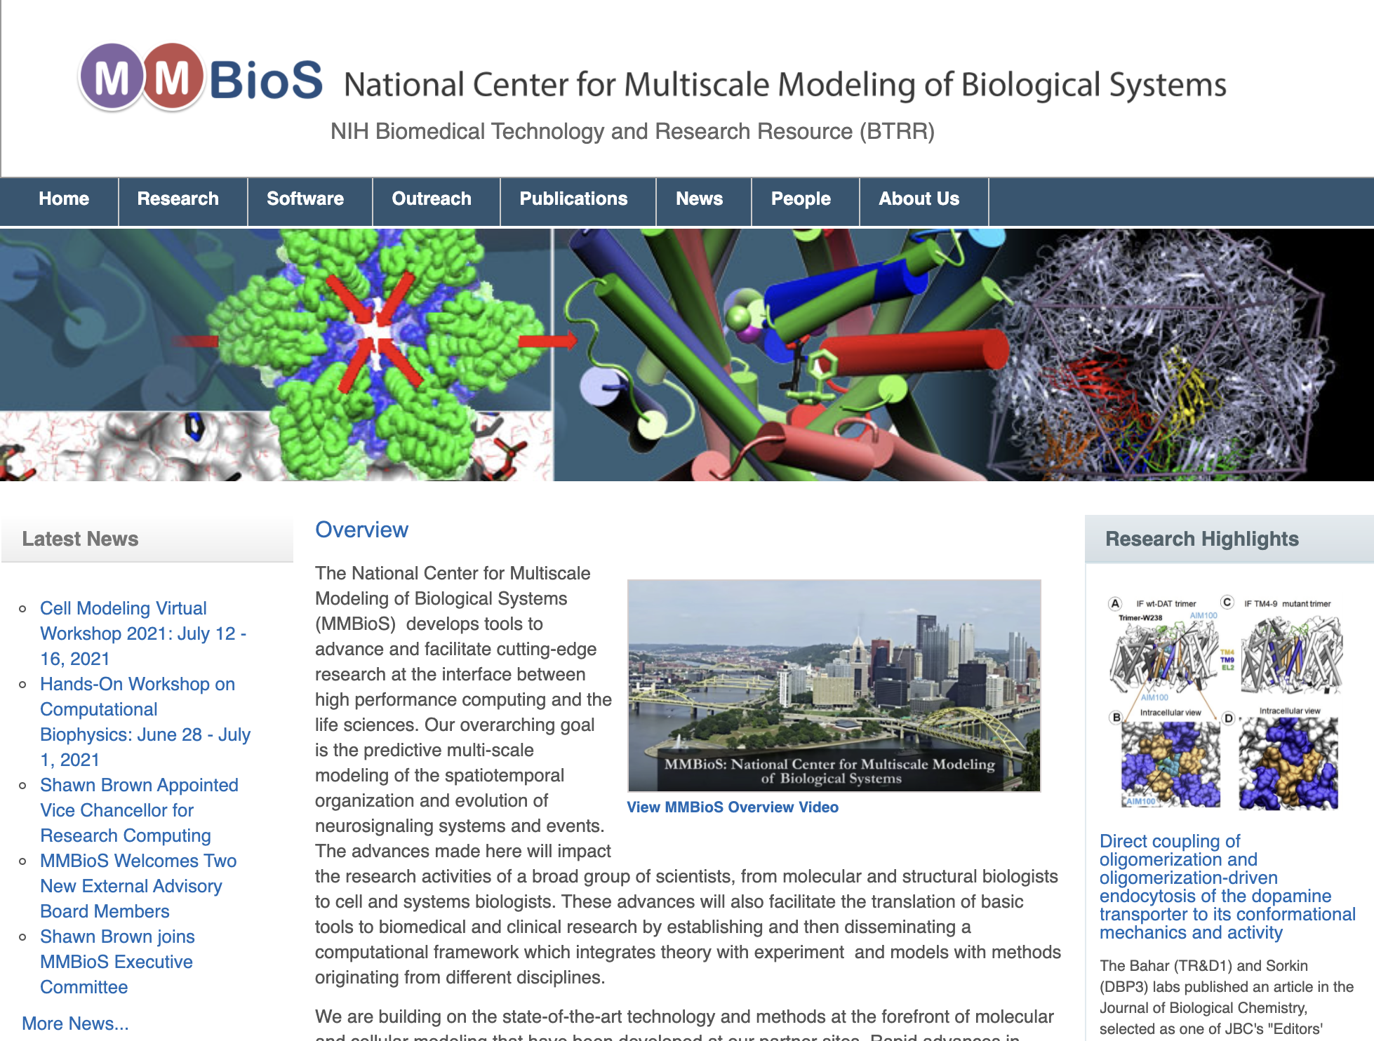
Check us out on mmbios.org

Slide 12

MMBioS Free Online Modeling Course
biologicalmodeling.org

Slide 13
Course Surveys
Your feedback is really important to us!
Please complete your daily surveys for each course component and the final survey
Also, please feel free to send us messages on Slack with your comments and suggestions
We are always aiming to improve our presentations and tools

